Slide 1
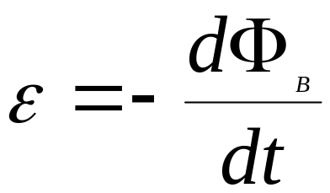
Faraday’s Law of Electromagnetic Induction
It was Michael Faraday who was able to link the induced current with a changing magnetic flux.
He stated that
The induced emf in a closed loop equals the negative time rate of change of the magnetic flux through the loop
The induced emf opposes the change that is occurring

Slide 2

LET’S UNDERSTAND FARADAY’S LAW
Basic Terminology
Electromotive Force ( ,E, V)
  known as emf, potential difference, or voltage
  unit is volt [V]
  “force” which causes electrons to move from one location to another
  operates like a pump that moves charges (predominantly electrons) through “pressure” (= voltage)

Slide 3
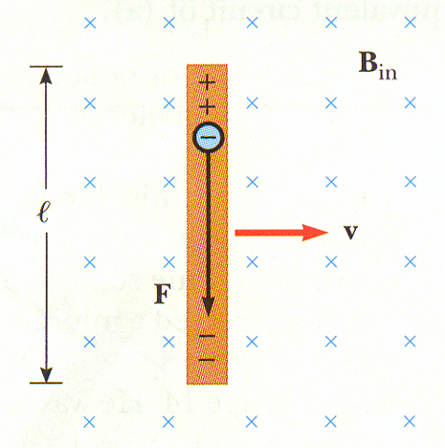
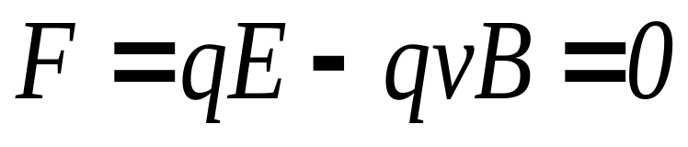
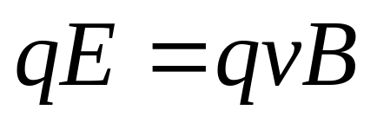
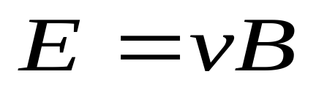
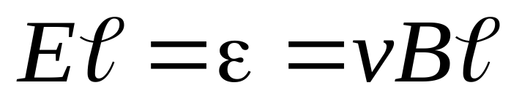
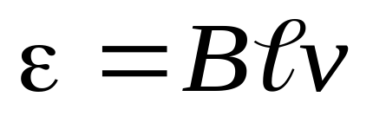
Faraday’s Experiment: Motional emf
Apply the Lorentz Force equation:

Slide 4
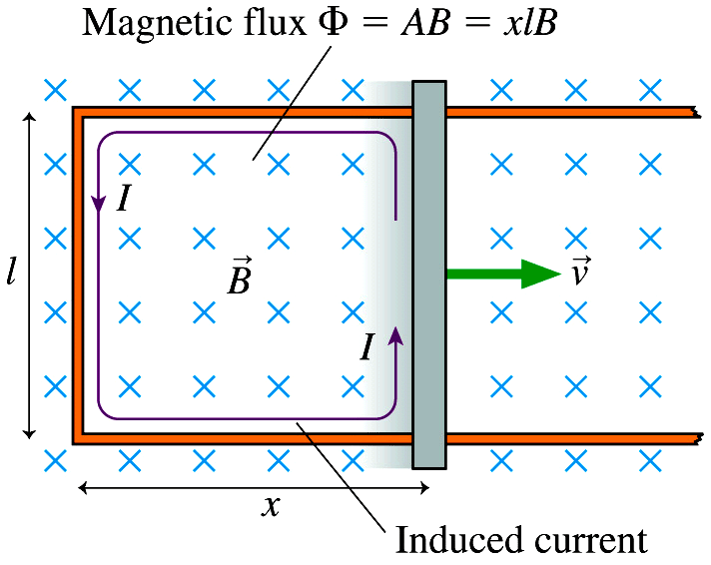
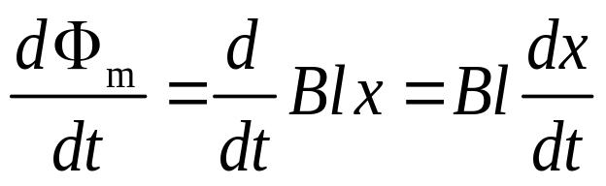
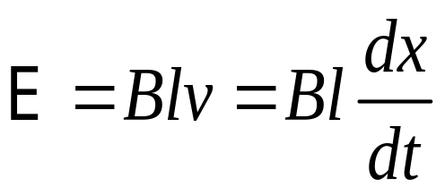
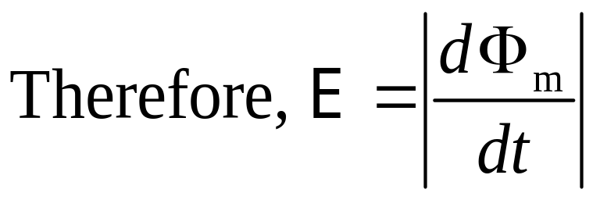
Faraday’s Experiment
Consider the loop shown:
And from last slide …
CONCLUSION: to produce emf one should make ANY change in a magnetic flux with time!

Slide 5
Polarity of the Induced Emf
The polarity (direction) of the induced emf is determined by Lenz’s law.
Including Lenz’s law, the Complete Faraday’s law becomes:
Let’s talk about Lenz’s law:

Slide 6
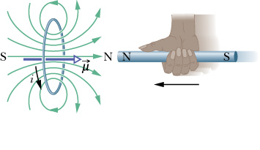
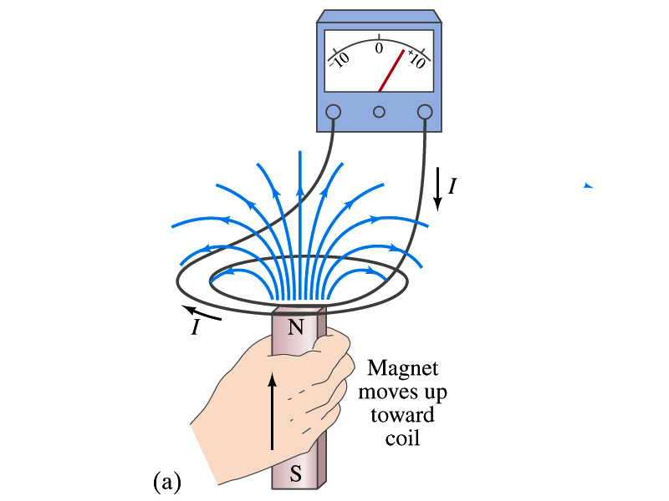
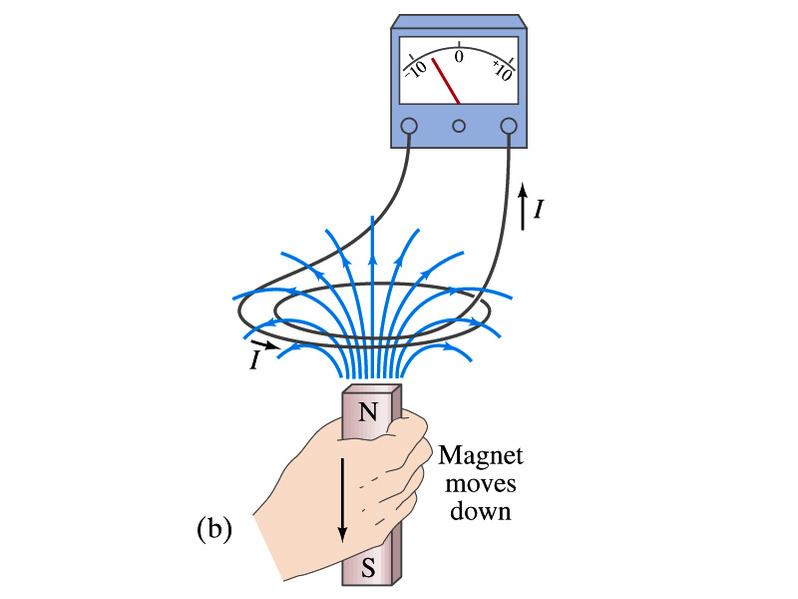
LENZ’S Law
The direction of the emf induced by changing flux will produce a current that generates a magnetic field opposing the flux change that produced it.

Slide 7
Another view of Lenz’s Law

N
S
I_{induced}
V+, V-
Lenz’s Law: emf appears and current flows that creates a magnetic field that opposes the change – in this case an decrease – hence the negative sign in Faraday’s Law.
Notes:
There is a negative sign in Faraday’s Law – and this is why.

Slide 8
Lenz’s Law

N
S
I_{induced}
V-, V+
Lenz’s Law: emf appears and current flows that creates a magnetic field that opposes the change – in this case an increase – hence the negative sign in Faraday’s Law.
Notes:
There is a negative sign in Faraday’s Law – and this is why.

Slide 9
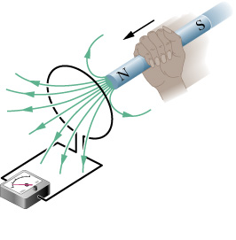
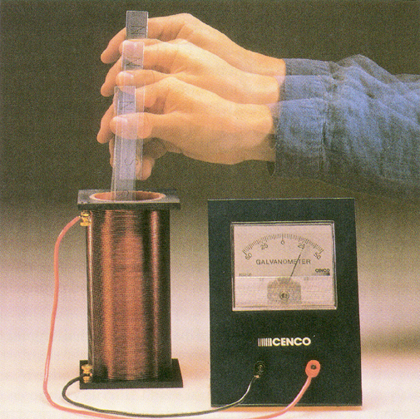
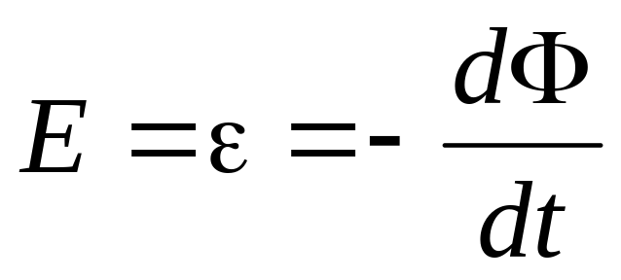
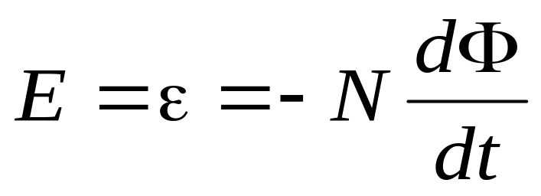
Faraday’s Law for a Single/ N Loops

Slide 10
More about Lenz's Law
Claim: Direction of induced current must be so as to oppose the change; otherwise conservation of energy would be violated.
    Why???
      If current reinforced the change, then the change would get bigger and that would in turn induce a larger current which would increase the change, etc..
  No perpetual motion machine!
  Conclusion: Lenz’s law results from energy conservation principle.

Slide 11
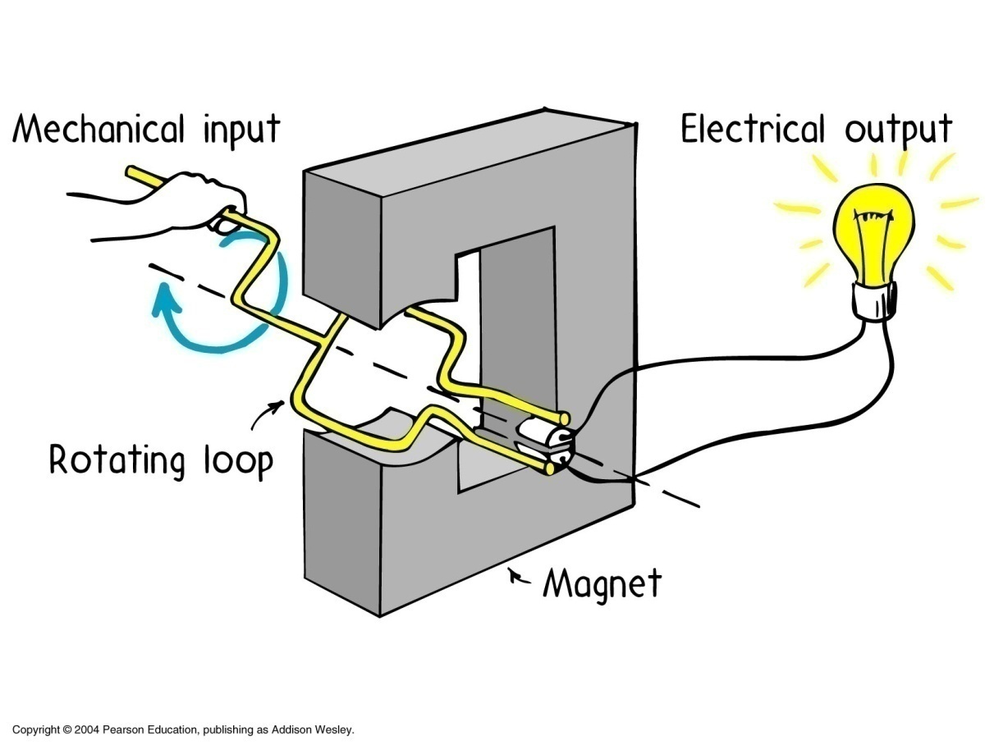
Applications of Magnetic Induction
AC Generator
  Water turns wheel
  → rotates magnet
  → changes flux
  → induces emf
  → drives current

Slide 12
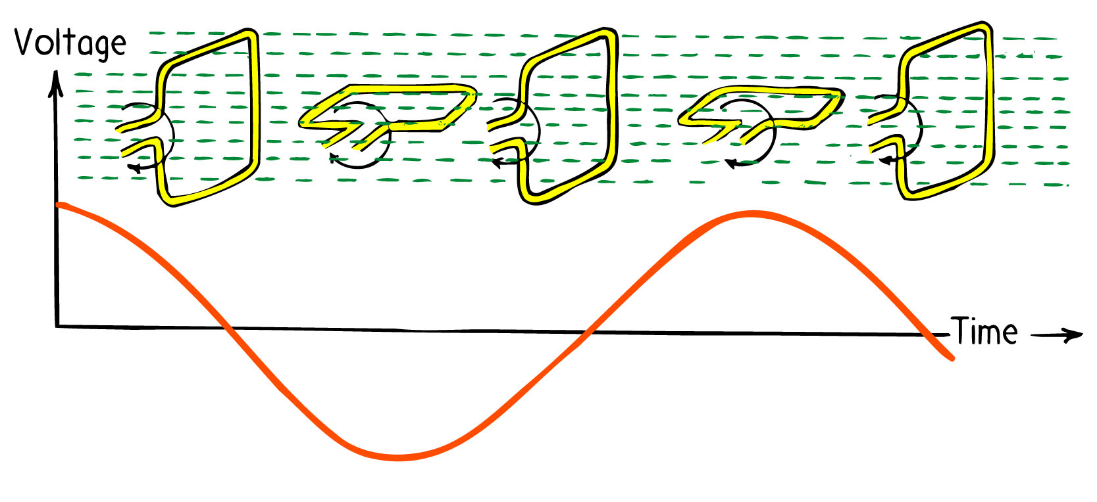
Single-Phase Generator

Slide 13
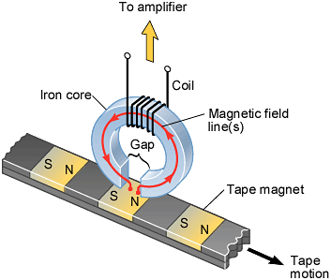
The Magnetic Playback Head of a Tape Deck

Slide 14
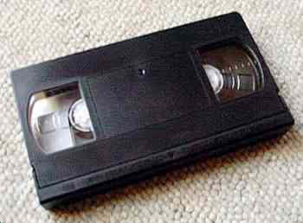
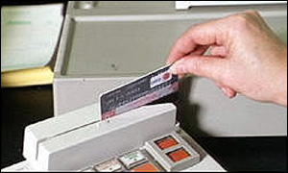
Tape / Hard Drive etc
  Tiny coil responds to change in flux as the magnetic domains go by (encoding 0’s or 1’s).
  Credit Card Reader
  Must swipe card
  → generates changing flux
  Faster swipe → bigger signal

